Slide 1

Green Budgeting in the EU
Implementing green budgeting in Belgium.
What does it mean? (FRDO-CFDD)
Simona Pojar, European Commission,
Directorate-General for Economic and Financial Affairs
21 December 2023

Slide 2
Outline
Definition and context
EU Green Budgeting Reference Framework
State of play in the EU
Green budgeting & the budget cycle
2024 Conference

Slide 3
Definition and context

Slide 4
A definition of green budgeting
A budgetary process whereby the environmental contributions of budgetary items are identified and assessed with respect to specific performance indicators, with the objective of better aligning budgetary policies with environmental goals.

Slide 5
Why green budgeting?
Budgets are one of the main expressions of how a government wants to implement its political ambition …
… aligning budgets with environmental objectives is a crucial tool for the green transition.
Important step for tackling Article 2.1(c) of the Paris Agreement: “making finance flows consistent with a pathway towards low GHG emissions and climate-resilient development.”

Slide 6
European Commission and green budgeting
Mandate from the European Green Deal (2019)
National budgets play a key role in the transition. A greater use of green budgeting tools will help to redirect public investment, consumption and taxation to green priorities and away from harmful subsidies. The Commission will work with the Member States to screen and benchmark green budgeting practices. This will make it easier to assess to what extent annual budgets and medium-term fiscal plans take environmental considerations and risks into account, and learn from best practices. The review of the European economic governance framework will include a reference to green public investment in the context of the quality of public finance.
Source: Communication on The European Green Deal EUR-Lex - 52019DC0640 - EN - EUR-Lex (europa.eu)

Slide 7
Commission work on Green Budgeting
Green budgeting survey + public database
Green Budgeting Website
Development of a Green Budgeting Reference Framework (GBRF)
Ongoing technical support to (23) Member States based on the GBRF
Annual green budgeting conferences and continued exchange with MS
Analytical work
Collaboration with the OECD and the IMF (Green Budgeting: Towards Common Principles)

Slide 8
EU Green Budgeting Reference Framework (GBRF)

Slide 9
Green Budgeting Reference Framework
Purpose
Support Member States embarking in green budgeting or willing to improve existing practices
Provide a reference for monitoring practices by the Commission
Main features
Builds on existing good practices of
  Public financial management
  GB methods across the EU
No ‘one-size-fits-all’ model
Consistency of practices across the EU
Flexible over time

Slide 10
Main elements
Methodology
Deliverables
Governance
Transparency
Accountability
Coverage

Slide 11
A phased approach
3 levels of development (applicable to each of the 5 key elements)
To allow flexibility in the development of national practices, given differences in budgetary approaches
Essential
Developed
Advanced

Slide 12
1. Coverage
Environmental objectives
Budgetary items
General government

Slide 13
Coverage: Environmental objectives
Level 1
ESSENTIAL
Climate-related
Level 2
DEVELOPED
Climate-related
Other objectives
Level 3
ADVANCED
All objectives

Slide 14
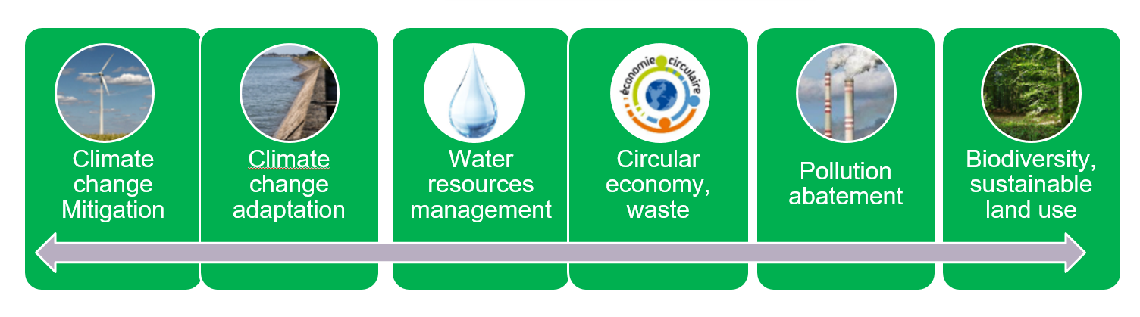
Example: EU Taxonomy objectives
Countries examples: Austria, France, Greece, Ireland, Spain

Slide 15
Coverage: Budgetary items
Level 1
ESSENTIAL
Favourable items (both revenue and expenditure)
Level 2
DEVELOPED
Level 3
ADVANCED
Favourable items
Unfavourable items
Tax expenditure
Favourable items
Unfavourable items
Unfavourable items: avoid doing good with one hand and undoing it with the other more coherent ‘policy package’.
More and more countries capture also unfavourable items.
Only few cases cover tax expenditure.

Slide 16
Coverage: General government
Level 1
ESSENTIAL
Central-government
Level 2
DEVELOPED
Central-government
Level 3
ADVANCED
Central-government
Other (e.g. State-owned enterprises)
Sub-national governments
Sub-national governments
In practice, mostly limited to the central government.

Slide 17
2. Methodology
Level 1
ESSENTIAL
Tagging methodology
Level 2
DEVELOPED
Tagging methodology
Level 3
ADVANCED
Ex-ante impact assessment of policies
Ex-post evaluation of policies
Tagging methodology

Slide 18
Example (1): Ireland
Examination of the entire budget
Binary approach: favourable / unfavourable only where it is evident that all, or at least the majority of investment in the programme in question, will support / not support improved climate and environmental outcomes.

Slide 19
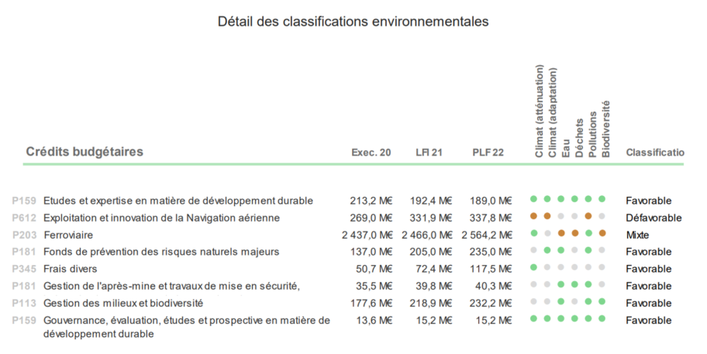
Example (2): France
Scrutiny of entire budget
Classification by each environmental objective (3 shades of green + non-classified)
Source: Rapport_impact_environnemental_budget_Etat_2022.pdf (economie.gouv.fr)

Slide 20
Example (2): France
Scrutiny of entire budget
Classification by environmental objective (3 shades of green)
Overall classification
  Favourable
  Unfavourable
  Mixed
Source: Rapport_impact_environnemental_budget_Etat_2022.pdf (economie.gouv.fr)

Slide 21
3. Deliverables
Level 1
ESSENTIAL
Presentation in annual budget
Level 2
DEVELOPED
Presentation in annual budget
Level 3
ADVANCED
Presentation in annual budget
Presentation in execution report
Presentation in execution report
Presentation of estimates in multi-annual plans
Presentation in execution report
Presentation of estimates in multi-annual plans
Extra-budgetary entities reports
A legal/administrative document should detail the content and calendar for deliverables.

Slide 22
Deliverables (examples)
France: green budget report attached to the draft budget presenting the tagging results.
Sweden: main outcomes (tagging results and impact assessment) in the annual budgetary plans.
Italy: eco-budget annex in draft budget and eco-execution annex with information by CEPA-CReMA and ministry.

Slide 23
4. Governance
Roles and responsibilities, timeline, deliverables clearly specified
Leadership assigned to the authority coordinating the budgetary process
Level 1
ESSENTIAL
Ad-hoc central task-force
Level 2
DEVELOPED
Permanent central structure
Level 3
ADVANCED
Permanent central structure
Green budgeting correspondents in line ministries

Slide 24
Governance (tagging - examples)
France:
Inter-ministerial working group (lead & performs tagging)
+ Central Budget Authority (supervision)
+ line ministries (consulted + tagging)
Ireland:
Central budget authority unit (lead & performs tagging)
+ line ministries (consulted)
Austria:
Green Budgeting Focal Point (in MoF, leads & performs tagging)
+ Central budget authority unit, line ministries (involved)
Italy:
MoF (performs tagging)
+ line ministries (review).
+ MoF prepares final report.
Spain:
Inter-ministerial working group (initiating)
+ MoF & General Budget Directorate (leading)
+ Line ministries (provide info for tagging)
+ MoF & GBD (final tags)
Luxembourg: Inspectorate of Finance (leads - guidance on tagging)
+ line ministries (perform tagging)
+ IoF (analysing tagging, prepares final report)

Slide 25
5. Transparency and accountability
Level 1
ESSENTIAL
All deliverables public
Level 2
DEVELOPED
All deliverables public
Level 3
ADVANCED
All deliverables public
Independent evaluation of methodology
Independent evaluation of deliverables
Parliamentary discussion
Independent evaluation of methodology
Independent evaluation of deliverables
Parliamentary discussion
Ex-post review
Independent evaluation of methodology

Slide 26
Accountability (examples)
Independent evaluations:
Methodology in France discussed with think-tanks.
Evaluation of policies (Sweden, Netherlands); advice with comply-or-explain principle (Ireland).
Evaluations of budgeting reports (Italian Court of Auditors, European Court of Auditors issues regular assessments for climate tracking and soon for biodiversity).
Role of the Parliament:
Italy: obligation to send reports to Parliament.
Denmark: the Minister for Climate, Energy and Utilities must present a report on the effects of the government climate policy and answer any questions in the parliament.

Slide 27
State of play in the EU
- based on 2023 Commission survey -

Slide 28
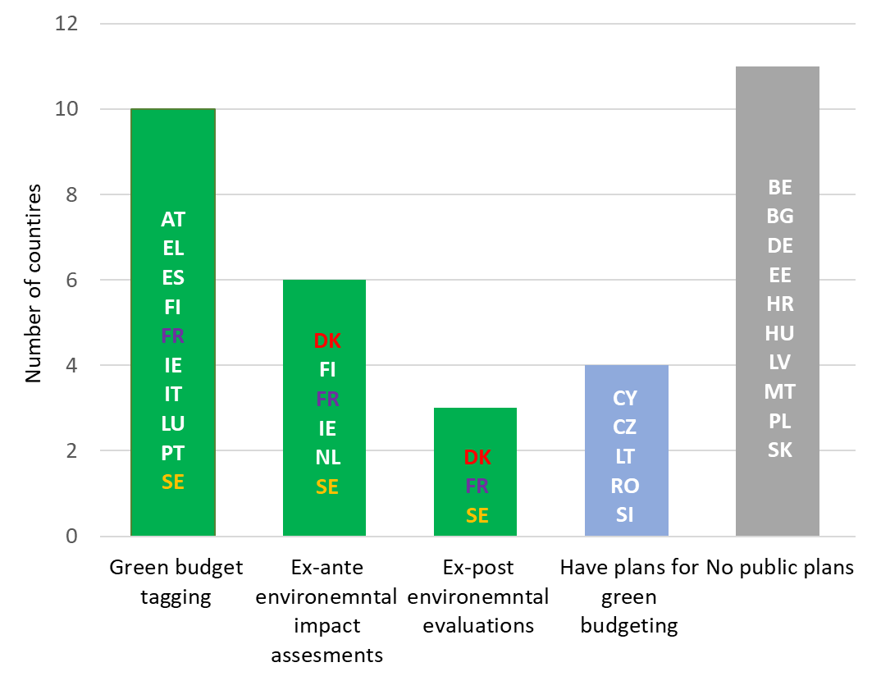
Green Budgeting practices
Note: Coloured countries apply several green budgeting tools.
Source: 2023 European Commission survey on green budgeting

Slide 29
Other tools

Slide 30
Key challenges

Slide 31
Green budgeting & the budget cycle

Slide 32
Main findings
Integrating green budgeting in the regular budget process is crucial to influence policy development.
In-debt interviews with selected countries.
Often not integrated into the budget law.
Green budgeting tools are commonly used during the budget preparation & negotiation phase.
Green budgeting has so far been used to provide transparency and less so to decide on the budget.
Available at: How Green Budgeting is Embedded in National Budget Processes (europa.eu)

Slide 33
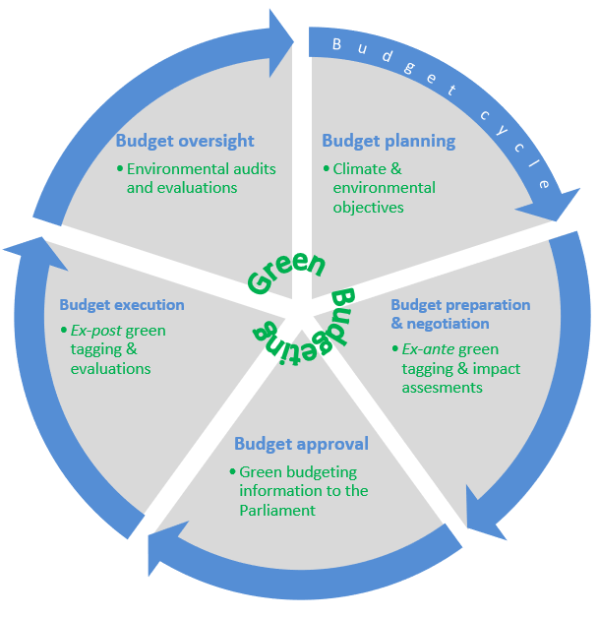
Green budgeting & the budget cycle

Slide 34
2024 Green Budgeting Conference

Slide 35
Green Budgeting in the EU: a coherent approach for improved policy making
4th Annual ECFIN Green Budgeting Conference organised jointly with the Belgian Federal Public Service (FPS) Policy and Support.
Brussels, 21 March 2024.
Synergies and coherence between green budgeting and the various green tools (green budgeting for the EU Budget, EU taxonomy, EHS, green bonds, Recovery and Resilience Plans).

Slide 36

Thank you!
© European Union 2020
Unless otherwise noted the reuse of this presentation is authorised under the CC BY 4.0 license. For any use or reproduction of elements that are not owned by the EU, permission may need to be sought directly from the respective right holders.
Slide xx: element concerned, source: e.g. Fotolia.com; Slide xx: element concerned, source: e.g. iStock.com
Notes:
Update/add/delete parts of the copy right notice where appropriate.
More information: https://myintracomm.ec.europa.eu/corp/intellectual-property/Documents/2019_Reuse-guidelines%28CC-BY%29.pdf

Slide 37
Annexes: Commission proposal for a reform of the Economic governance
- Green aspects of the Budgetary Framework Directive -

Slide 38
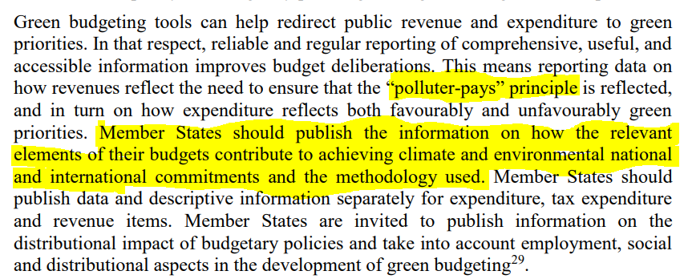
1. A greener budget: recital 19 of Directive

Slide 39
2. A more climate-resilient budget
Art 9(2)d of amended Directive requires MS to produce assessments:
specifying, to the extent possible, the macrofiscal risks from climate change as well as environmental and distributional impacts, and the implications on public finances of climate-related policies.
Art 14(3) of amended Directive requires MS to publish:
information on disaster and climate-related contingent liabilities to the extent possible;
information on economic losses incurred due to disasters and climate-related shocks, including the fiscal costs borne by the public sector and the instruments used to mitigate or cover them.

